Slide 1

A behavioral insight platform for coaches and coachees.
Nu
d
ge
The
Machine
By Stefano Picozzi
March 2014
© StefanoPicozzi@gmail.com 2014

Slide 2
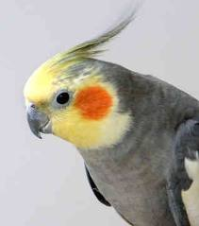
The Nudge Machine
To help people who wish to help themselves, wherever they are, whenever they need it
By building a behavioral insight platform to support coaches and coachees through small and large scale behavioral change intervention programs
So that coachees can set and track goals and so that coaches can provide tailored instruction and feedback both inside or outside the classroom.
© StefanoPicozzi@gmail.com 2014

Slide 3
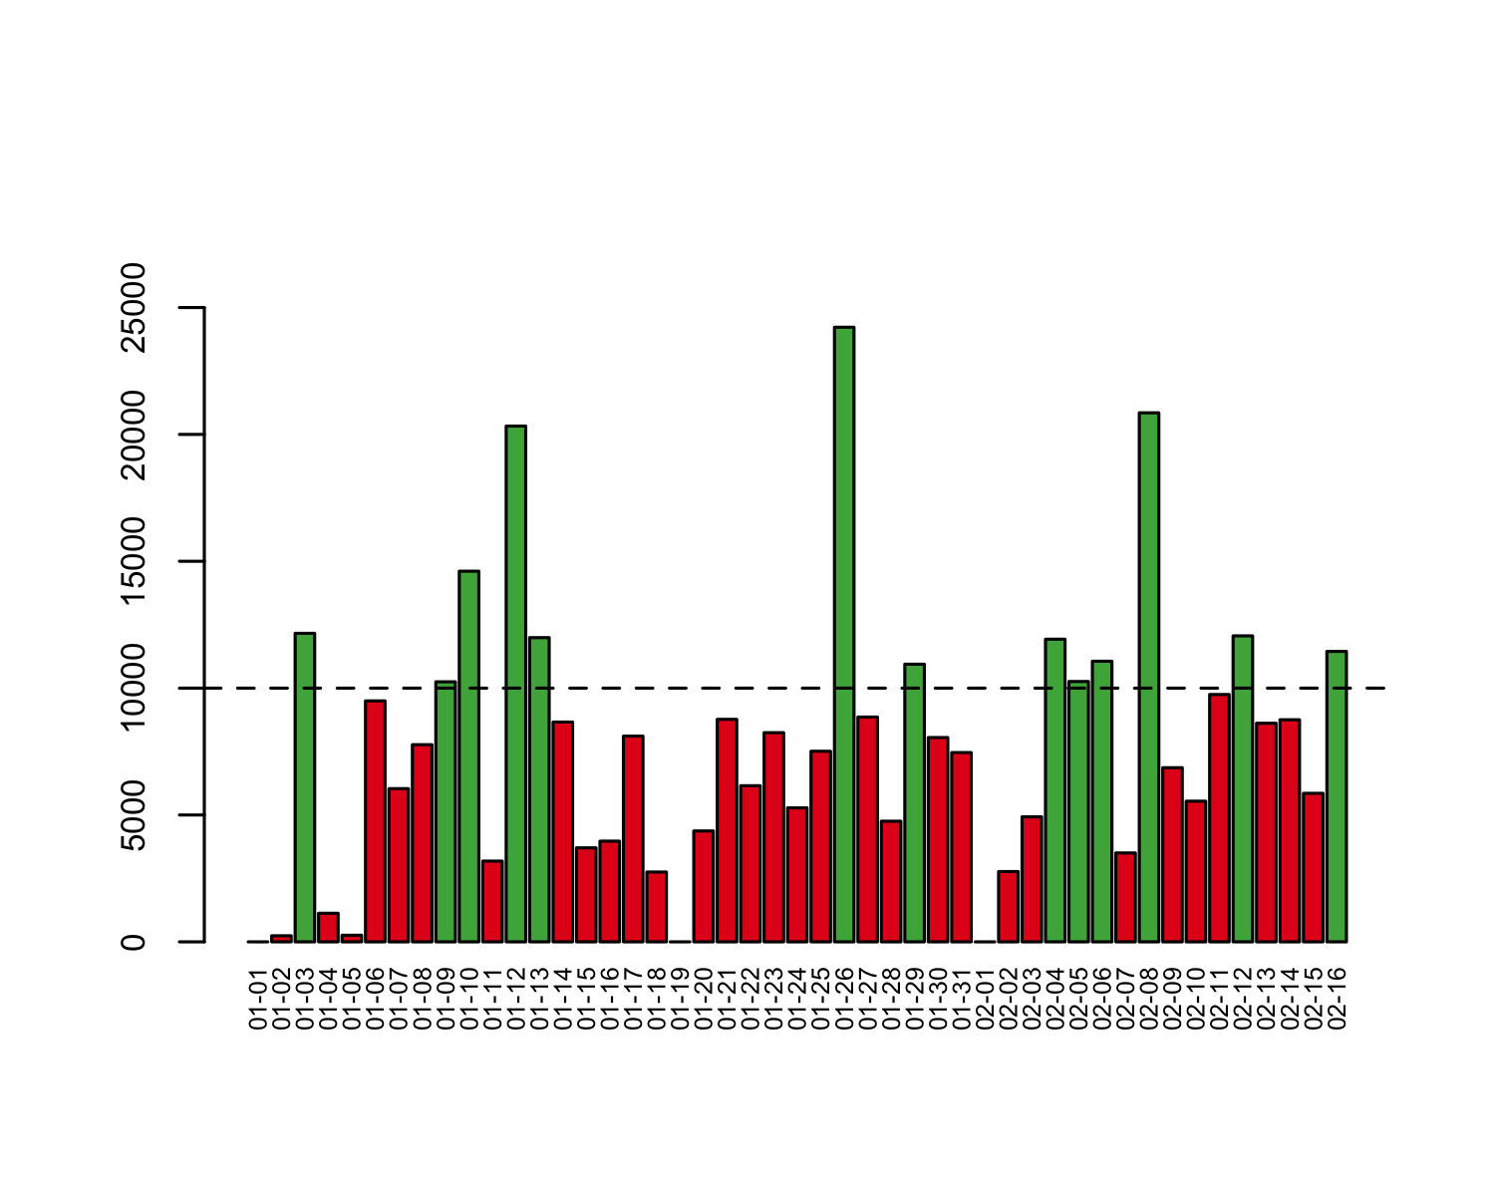

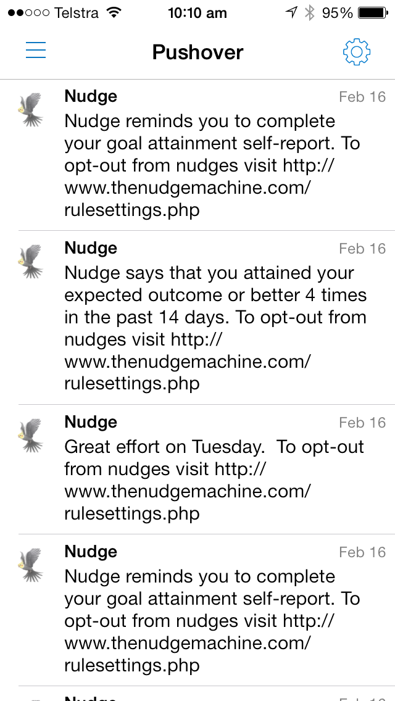

Behavioral Observations
Inputs can be sourced from self-report, direct entry, sensor captured, 3rd party applications
Nu
d
The
ge
Machine
Nudges can be directed to mobile app, sms, email, web-site, 3rd party application etc
c
Behavioral
Rules Based
Event Stream Engine
Coachee
Coachee
Coachee
Goal Setting
If-then planning
Opt-in Opt-out
Behavioral
Insights
Behavioral Query Language
Goal Attainment Scale
Opt-in/out
Self Report Reminder
Cloud based service exposing REST APIs via subscription to 3rd party applications
Ad Hoc Nudge
Snap Poll
Coach
Nudge Schedule
© StefanoPicozzi@gmail.com 2014

Slide 4
Behavioral Observations
Nu
d
Inputs can be sourced from self-report, direct entry, sensor captured, 3rd party applications
ge
The
Machine
Coachee
Outputs can be directed to mobile app, sms, email, web-site, 3rd party application etc
c
Behavioral
Rules Based
Event Stream Engine
Coachee
Behavioral Insights
Coachee
Goal Setting
If-then planning
Opt-in Opt-out
Rule Goal Attainment
Rule Average Steps
Rule Goal Self Report
Rule Quiet Sunday
…
Behavioral Query Language
Cloud based service exposing REST APIs via subscription to 3rd party applications
Coach
© StefanoPicozzi@gmail.com 2014

Slide 5
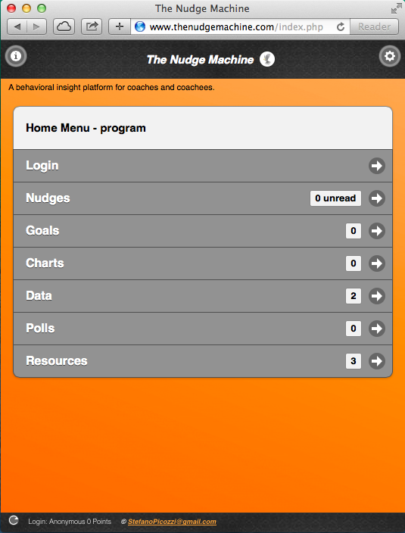
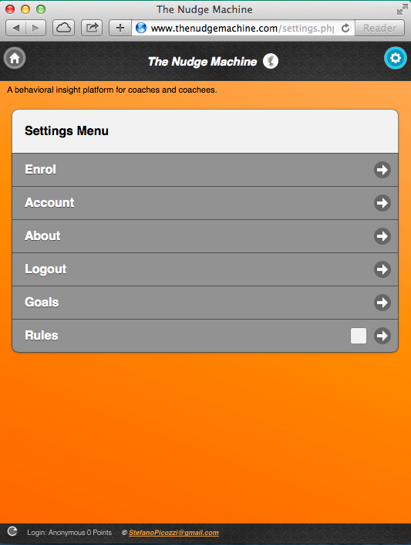
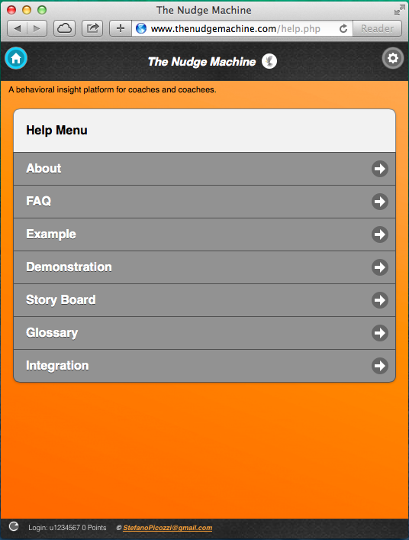
Coachee Functional Prototype
Home Menu
Settings Menu
Help Menu
© StefanoPicozzi@gmail.com 2014

Slide 6
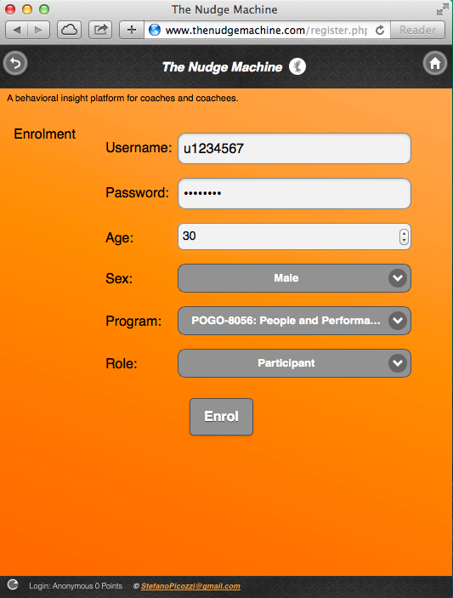
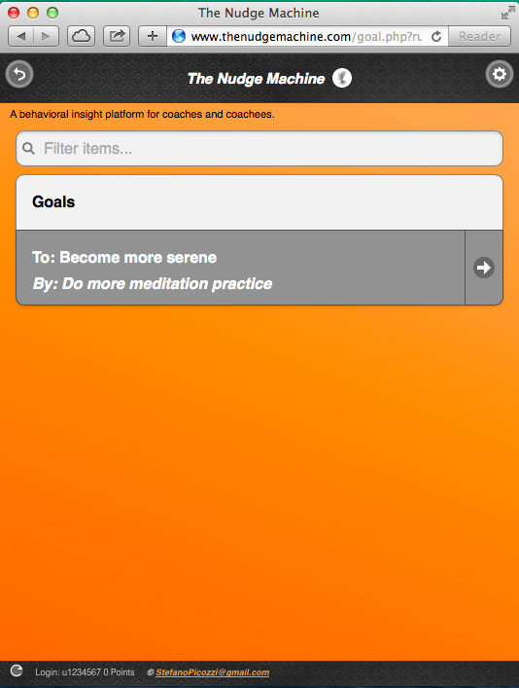
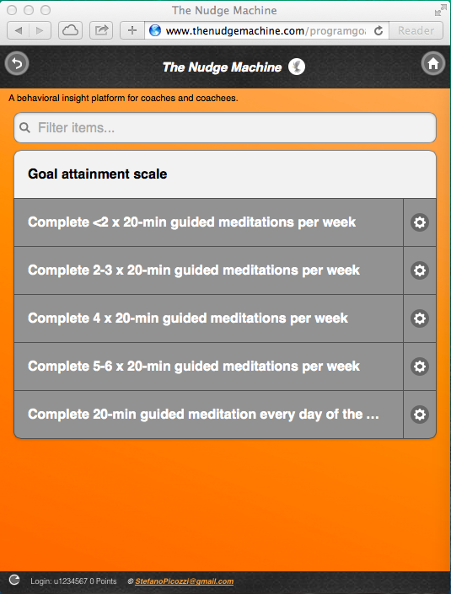
Coachee Functional Prototype
Enrolment
Goal Setting
Goal Scales
© StefanoPicozzi@gmail.com 2014

Slide 7
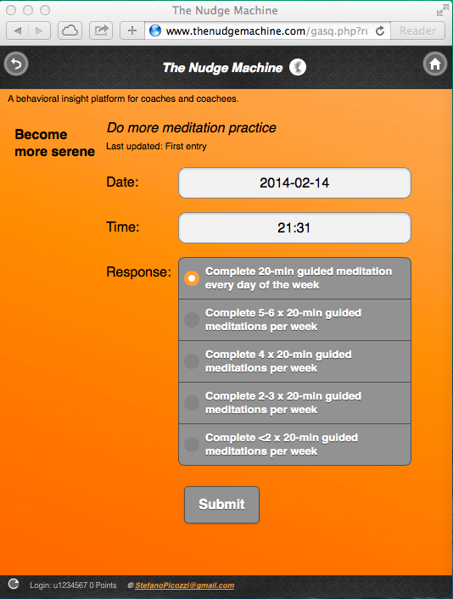
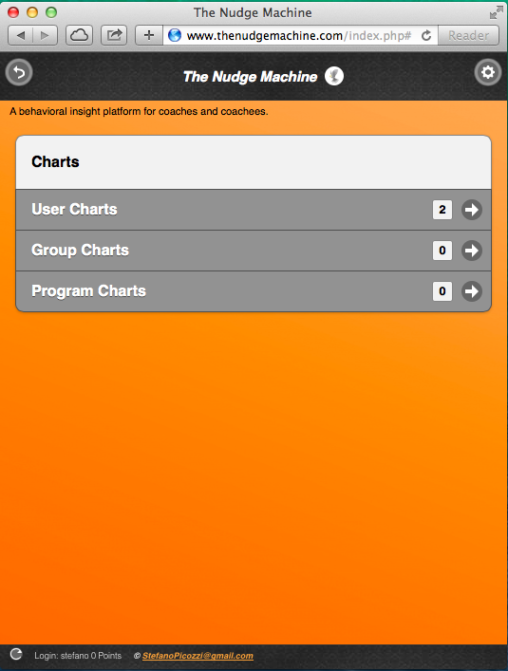
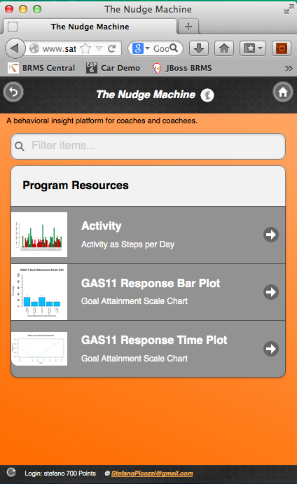
Coachee Functional Prototype
Goal Self Report
Charts
Chart Types
© StefanoPicozzi@gmail.com 2014

Slide 8
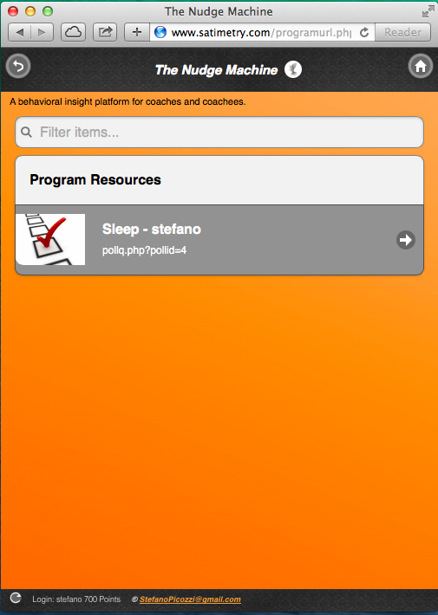
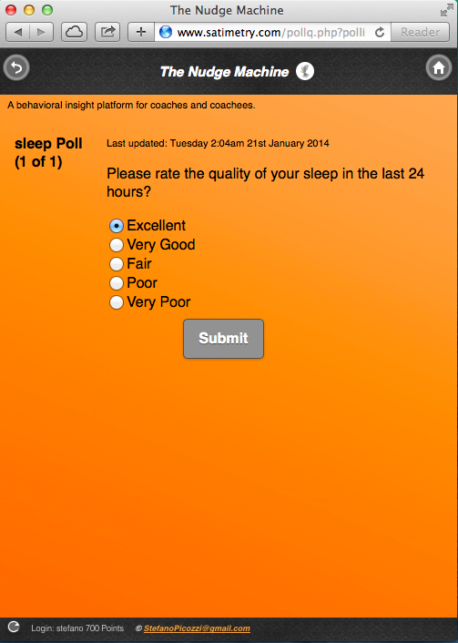
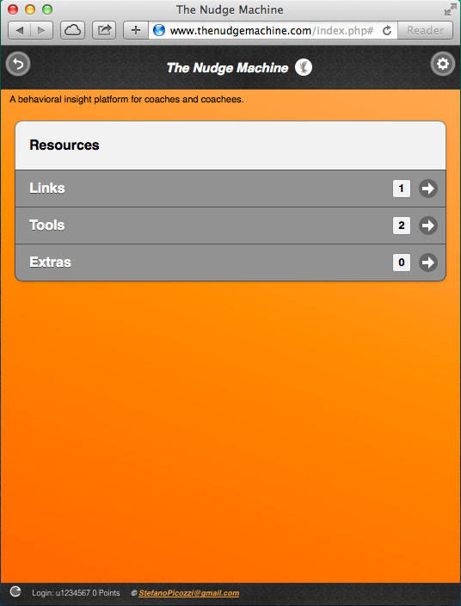
Coachee Functional Prototype
Polls
Poll Example
Resources
© StefanoPicozzi@gmail.com 2014

Slide 9
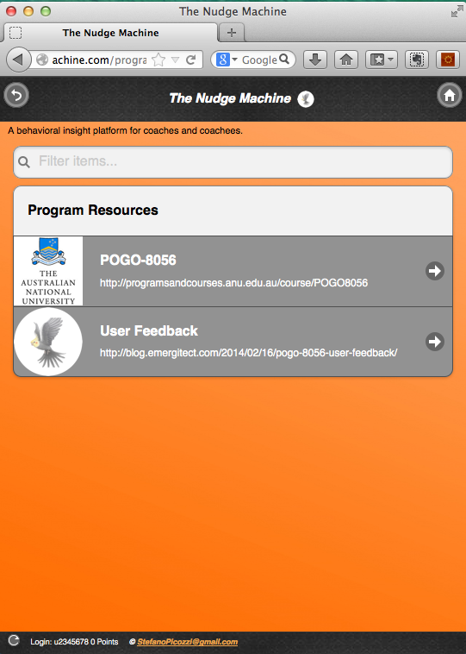
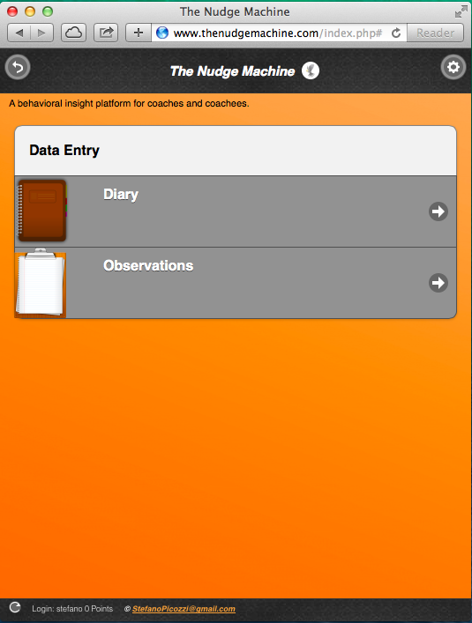
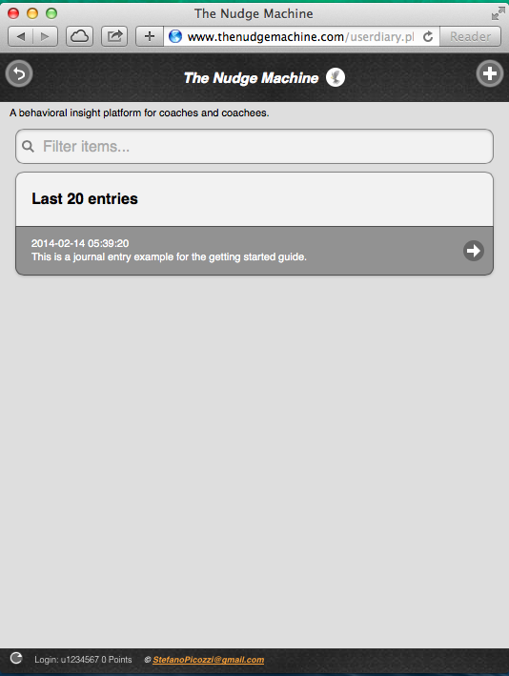
Coachee Functional Prototype
Links
Data Entry
Journals
© StefanoPicozzi@gmail.com 2014

Slide 10
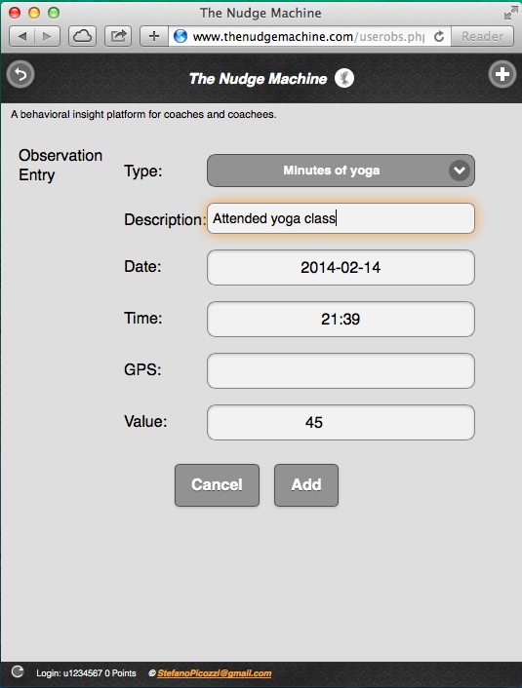
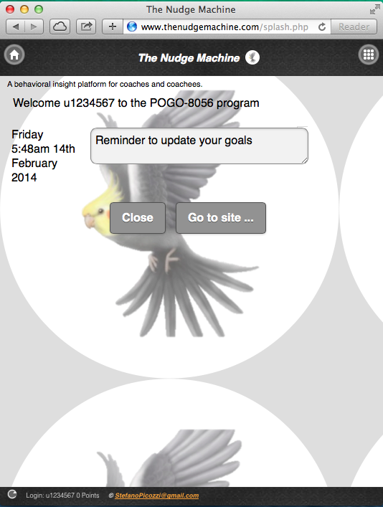
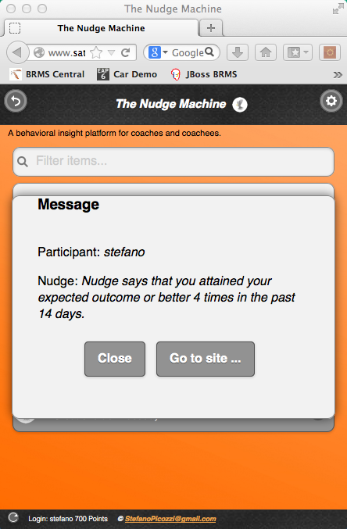
Coachee Functional Prototype
Observation Entry
Splash Screen
Nudges
© StefanoPicozzi@gmail.com 2014

Slide 11
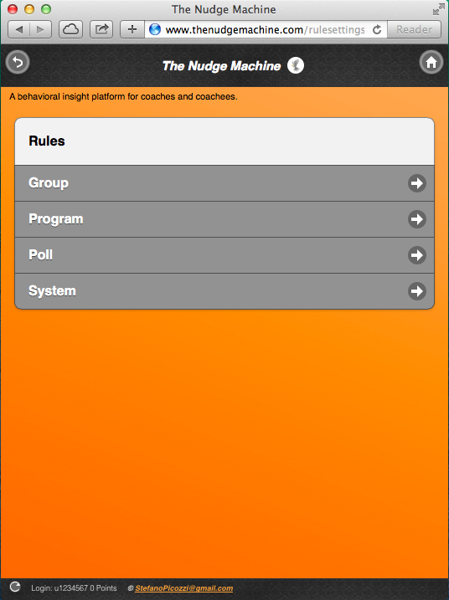
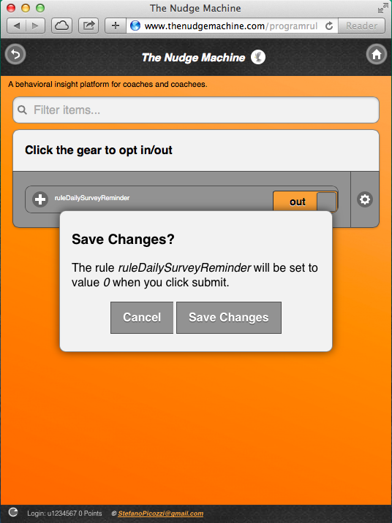
Coachee Functional Prototype
Rule Settings
Rule Opt in-out
Mobile Notifcations
© StefanoPicozzi@gmail.com 2014

Slide 12
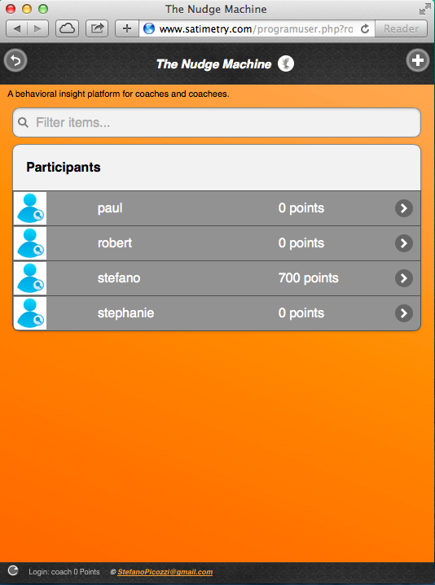
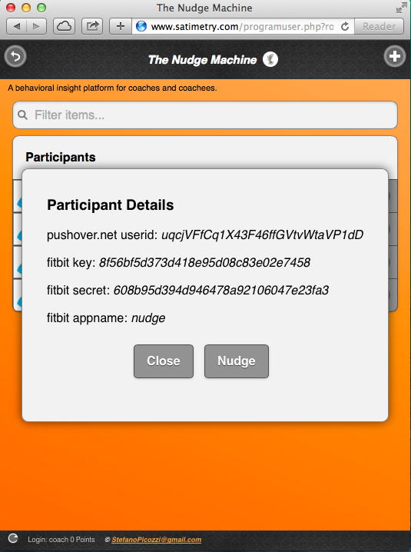
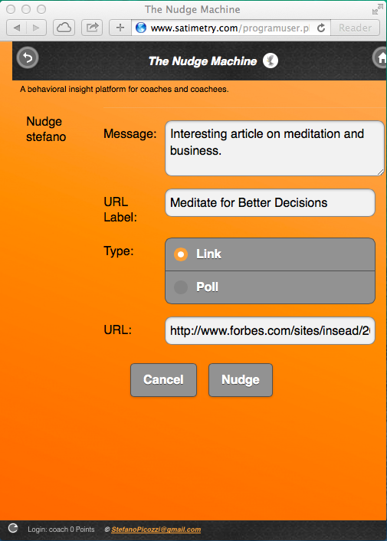
Coach Functional Prototype
Coachee List
Nudge Coachee
Ad hoc Nudge
c
© StefanoPicozzi@gmail.com 2014

Slide 13
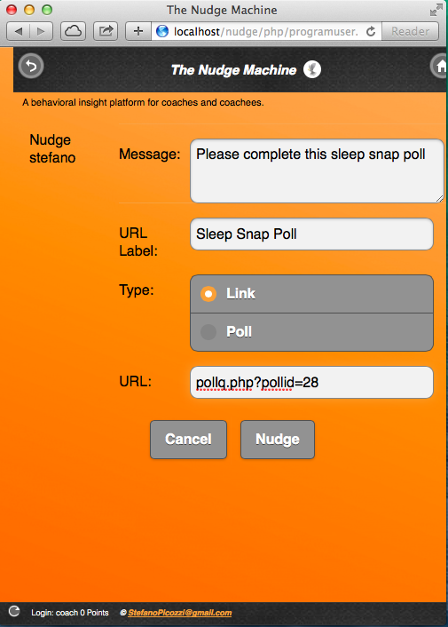
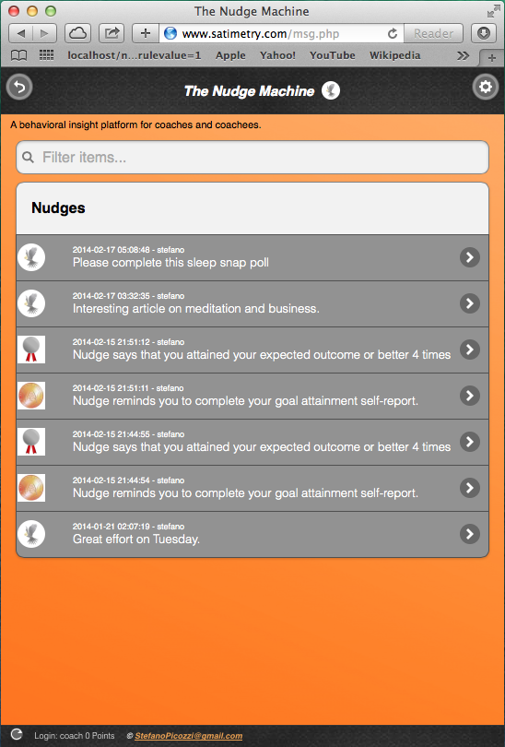
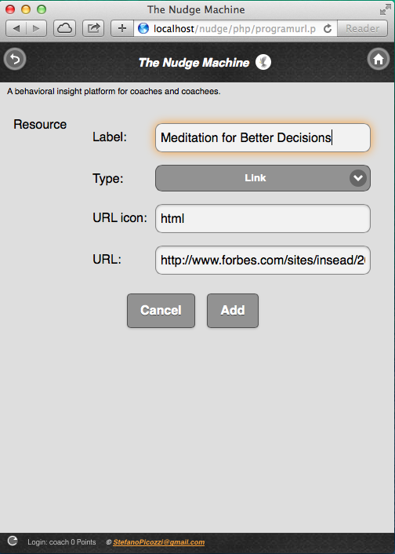
Coach Functional Prototype
Snap Poll
Nudges
Add Resources
© StefanoPicozzi@gmail.com 2014

Slide 14
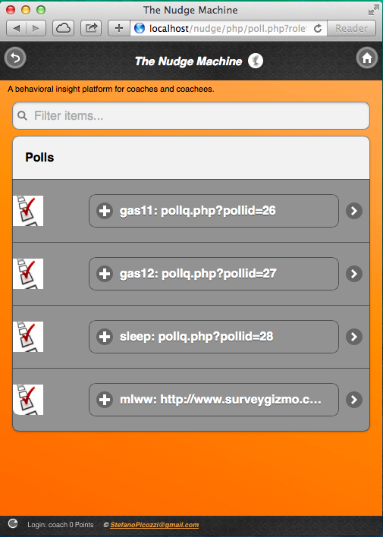
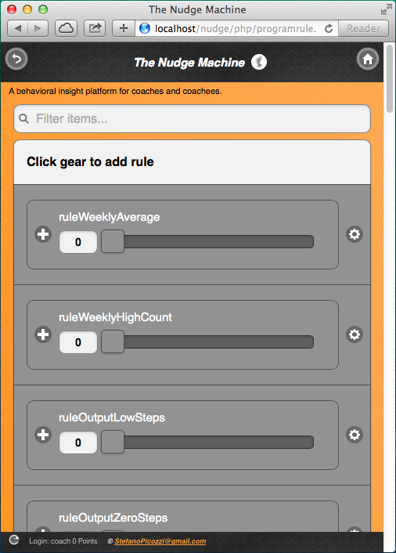
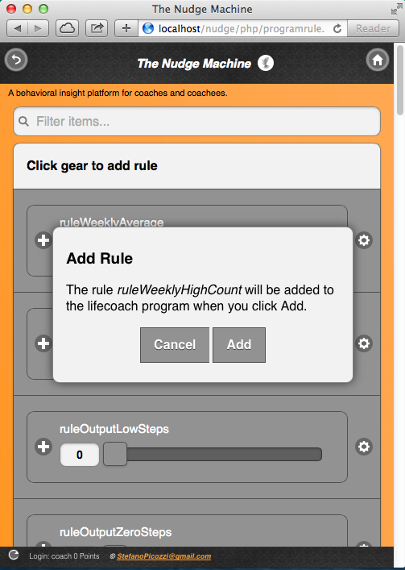
Coach Functional Prototype
Polls
Rule Assignment
Assign
© StefanoPicozzi@gmail.com 2014

Slide 15
Libertarian Paternalism
is paternalism in the sense that “it tries to influence choices in a way that will make choosers better off, as judged by themselves”
it is libertarian in the sense that it aims to ensure that “people should be free to opt out of specified arrangements if they choose to do so.”
the possibility to opt out is said to “preserve freedom of choice”.
© StefanoPicozzi@gmail.com 2014

Slide 16
A behavioral insight platform for coaches and coachees.
Nu
d
ge
The
Machine
By Stefano Picozzi
March 2014
© StefanoPicozzi@gmail.com 2014

